Slide 1
Sound and Speech Recognition

Slide 2
What is Sound ?
Acoustics is the study of sound.
Physical - sound as a disturbance in the air
Psychophysical - sound as perceived by the ear
Sound as stimulus (physical event) & sound as a sensation.
Pressures changes (in band from 20 Hz to 20 kHz)
Physical terms
Amplitude
Frequency
Spectrum

Slide 3
Sound Waves
In a free field, an ideal source of acoustical energy sends out sound of uniform intensity in all directions. => Sound is propagating as a spherical wave.
Intensity of sound is inversely proportional to the square of the distance (Inverse distance law).
6 dB decrease of sound pressure level per doubling the distance.

Slide 4
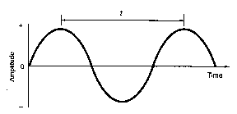
Sound Waves

Slide 5
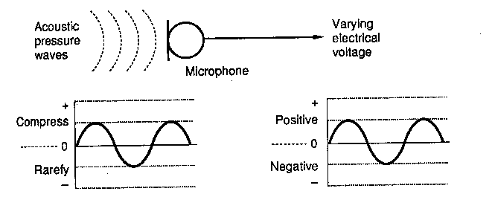
What is Sound

Slide 6
How we hear
Ear connected to the brain
left brain: speech
right brain: music
Ear's sensitivity to frequency is logarithmic
Varying frequency response
Dynamic range is about 120 dB (at 3-4 kHz)
Frequency discrimination 2 Hz (at 1 kHz)
Intensity change of 1 dB can be detected.

Slide 7
Digitizing Sound

Slide 8
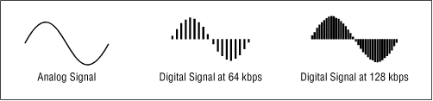
Digitally Sampling

Slide 9
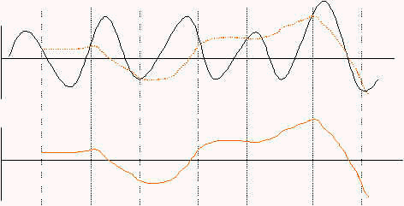
Undersampling

Slide 10
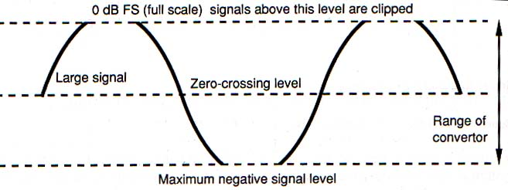
Clipping

Slide 11
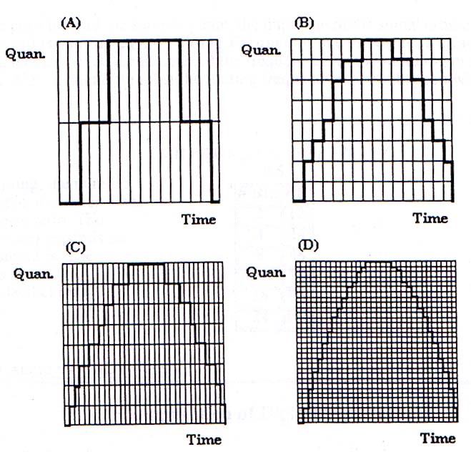
Quantization

Slide 12
Digital Sampling
Sampling is dictated by the Nyquist sampling theorem which states how quickly samples must be taken to ensure an accurate representation of the analog signal.
The Nyquist sampling theorem states that the sampling frequency must be two times greater than the highest frequency in the original analog signal.
or

Slide 13
Dithering a Sampled Signal
Analog signal added to the signal to remove the artifacts of quantization error.
Dither causes the audio signal to always move between quantization levels.
Otherwise, a low level signal would be encoded as a square wave => granulation noise.
Dithered, the A/D converter output is signal + noise => perceptually preferred, since noise is better tolerated than distortion.
Amplitude of dither signal: high dither amplitudes more easily remove quantization artifacts too much dither decreases the signal-to-noise ratio

Slide 14
Common Sound Sampling Parameters
Common Sampling Rates
8KHz (Phone) or 8.012820513kHz (Phone, NeXT)
11.025kHz (1/4 CD std)
16kHz (G.722 std)
22.05kHz (1/2 CD std)
44.1kHz (CD, DAT)
48kHz (DAT)
Bits per Sample
8 or 16
Number of Channels
mono/stereo/quad/ etc.

Slide 15
Audio Data Rates
Quality | Format (examples) | Transfer Rate | Disk Space 1 hour | Disk Space 100,000 hours
Netcasting | RealAudio | 20 Kbit/s | 8.8 MByte | 0.9 TByte
Preview | RealAudio | 80 Kbit/s | 35.2 MByte | 3.5 TByte
Preview | MPEG Layer 3 (MP3) | 192 Kbit/s | 84.4 MByte | 8.4 TByte
Broadcasting or Editing | MPEG Layer 2 | 384 Kbit/s | 168.8 MByte | 16.9 TByte
Archive (uncompressed) | Waveform PCM | 1538 Kbit/s | 675.9 MByte | 67.6 TByte

Slide 16
Space/Storage Requirements
1 Minute of Sound

Slide 17
Many (!) Sound File Formats
Mulaw (Sun, NeXT) .au
RIFF (Resource Interchange File Format)
MS WAV and .AVI
MPEG Audio Layer (MPEG) .mpa .mp3
AIFC (Apple, SGI) .aiff .aif
HCOM (Mac) .hcom
SND (Sun, NeXT) .snd
VOC (Soundblaster card proprietary standard) .voc
AND MANY OTHERS!

Slide 18
What’s in a Sound File Format
Header Information
Magic Cookie
Sampling Rate
Bits/Sample
Channels
Byte Order
Endian
Compression type
Data

Slide 19
Example File Format (NIST SPHERE)
NIST_1A
1024
sample_rate -i 16000
channel_count -i 1
sample_n_bytes -i 2
sample_byte_format -s2 10
sample_sig_bits -i 16
sample_count -i 594400
sample_coding -s3 pcm
sample_checksum -i 20129
end_head

Slide 20
WAV file format (Microsoft) RIFF
A collection of data chunks.
Each chunk has a 32-bit Id
followed by a 32-bit chunk length
followed by the chunk data.
0x00 chunk id 'RIFF'
0x04 chunk size (32-bits)
0x08 wave chunk id 'WAVE'
0x0C format chunk id 'fmt '
0x10 format chunk size (32-bits)
0x14 format tag (currently pcm)
0x16 number of channels 1=mono, 2=stereo
0x18 sample rate in hz
0x1C average bytes per second
0x20 number of bytes per sample
1 = 8-bit mono
2 = 8-bit stereo or
16-bit mono
4 = 16-bit stereo
0x22 number of bits in a sample
0x24 data chunk id 'data'
0x28 length of data chunk (32-bits)
0x2C Sample data

Slide 21
Digital Audio Today
Analog elements in the audio chain are replaced with digital elements.
16-bit wordlength, 32/44.1/48 kHz sampling rates.
Mostly linear signal processing.
Wide range of digital formats and storage media.
Rapid development of technology => better SNR, phase and linearity.
Rapid increase of signal processing power => possibility to implement new, complex features.
Soon: Digital radio (satellite), HDTV

Slide 22
Digital (CD) vs Analog (LP or cassette tape)
Information is stored digitally.
The length of its data pits represents a series of 1s and 0s.
Both audio channels are stored along the same pit track.
Data is read using laser beam.
Information density about 100 times greater than in LP.
CD player can correct disc errors.

Slide 23
Benefits of Digital Representation (CD)
Robust
No degradation from repeated playings because data is read by the laser beam.
Error correction
Transport’s performance does not affect the quality of audio reproduction.
Digital circuitry more immune to aging and temperature problems
Data conversion is independent of variations in disc rotational speed, hence wow and flutter are negligible.
SNR over 90 dB.
Subcode for display, control and user information

Slide 24
CD Format
Sampling
44.1 kHz => 10 % margin with respect to the Nyquist frequency (audible frequencies below 20 kHz)
16-bit linear => theoretical SNR about 98 dB (for sinusoidal signal with maximum amplitude)
audio bit rate 1.41 Mbit/s (44.1 kHz * 16 bits * 2 channels)
Cross Interleaved Reed-Solomon Code (CIRC) for error correction
Subcode
Original Specifications
Playing time max. 74.7 min
Disc diameter 120 mm
Disc thickness 1.2 mm
One sided medium, rotates clockwise
Signal is recorded from inside to outside
Pit is about 0.5 µm wide
Pit edge is 1 and all other areas whether inside or outside a pit, are 0s

